Slide 1
Afeka MiniTorrent
Alon Sandberg
Dan Presil

Slide 2
Known Bugs

Slide 3
Install Manual
Extract the project ZIP
Create a new database (SQL Server)
Run mediationserver as Admin
Run client

Slide 4
Core Classes and Methods
MediationServer | A WCF server – manages peers and their files
WPFClient | Peer desktop program – login, download and upload files
WPFClient: FileRequest.cs | Request files from other peers in the P2P network
WPFClient: FileRequestListener.cs | Handle download requests from other peers
DataAccessLayer | Database manager
WebPortal | Admin page, registration page, torrent monitor page

Slide 5
MediationServer
Handles peer login/logout
Prevents IP/Port conflics
Provides file information to peers in the network

Slide 6
FileRequest.cs
Sends a file request to other peers
Fires events on download progress
Fires events when downloads complete
FileRequestListener.cs
Listens to file requests
Gets a filename, sends file to peer if it exists

Slide 7
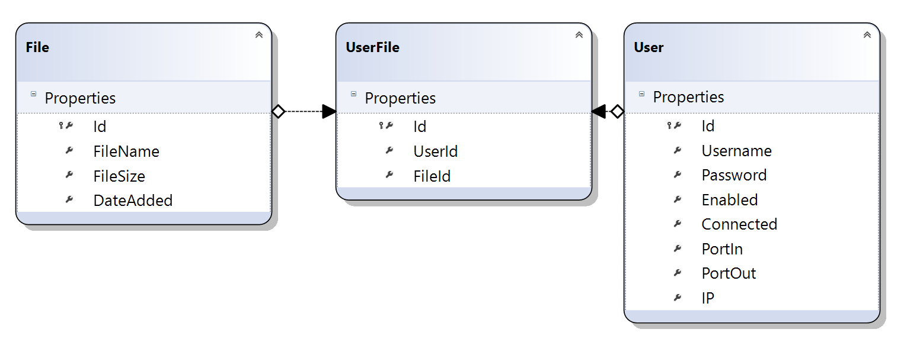
DataAccessLayer
List<File> GetFilesByFilename(bool fromConnectedUsersOnly, string filename = "")
User Register(string username, string password)
File InsertNewFile(string fileId, string fileName, string fileSize, int userId)

